Slide 1






Chicken Tractor
Prepared by:
L. Robert Barber, & Ilene Iriarte
For:
Guam Cooperative Extension Service & Guam Department of Agriculture
Funding provided by:
United States Department of Agriculture Natural Resources Conservation Service, Western Region Sustainable Agriculture Research and Education, Administration for Native Americans,, & Sanctuary Incorporated

Slide 2
Objectives
What is a chicken tractor?
How does the chicken tractor address the problems of garden preparation and weeding?
Describe various types of chicken tractors.
Benefits of having chicken tractors.

Slide 3
What is a Chicken Tractor?
A chicken tractor is basically a mobile floorless chicken pen.
  A light weight easily moved pen.
  It provides shelter, nesting and roosting area and contains water and feed sources

Slide 4
Benefits of Owning a Chicken Tractor
You get nutrient rich soil, ready to plant in three to four weeks.
Soil stays relatively weed free for about 3-4 months.
A form of pest control
Chickens add fertilizer to your soil
A steady supply of eggs, and meat.

Slide 5
Considerations before adopting the the Chicken Tractor Method
How much are you willing to spend on the chicken tractor?
How many chickens do you plan on keeping
How much area do you need to cover?

Slide 6
Preparation, Tilling, and Weeding.
Chicken tractors keep the chickens confined to one specific area.
Natural feeding behavior is focused on plant and insect life in the soil within the area.
One chicken clears about 3-4 square feet in about 2-3 weeks.
Their manure is concentrated and mixed directly with the soil providing nutrients for the garden bed.

Slide 7
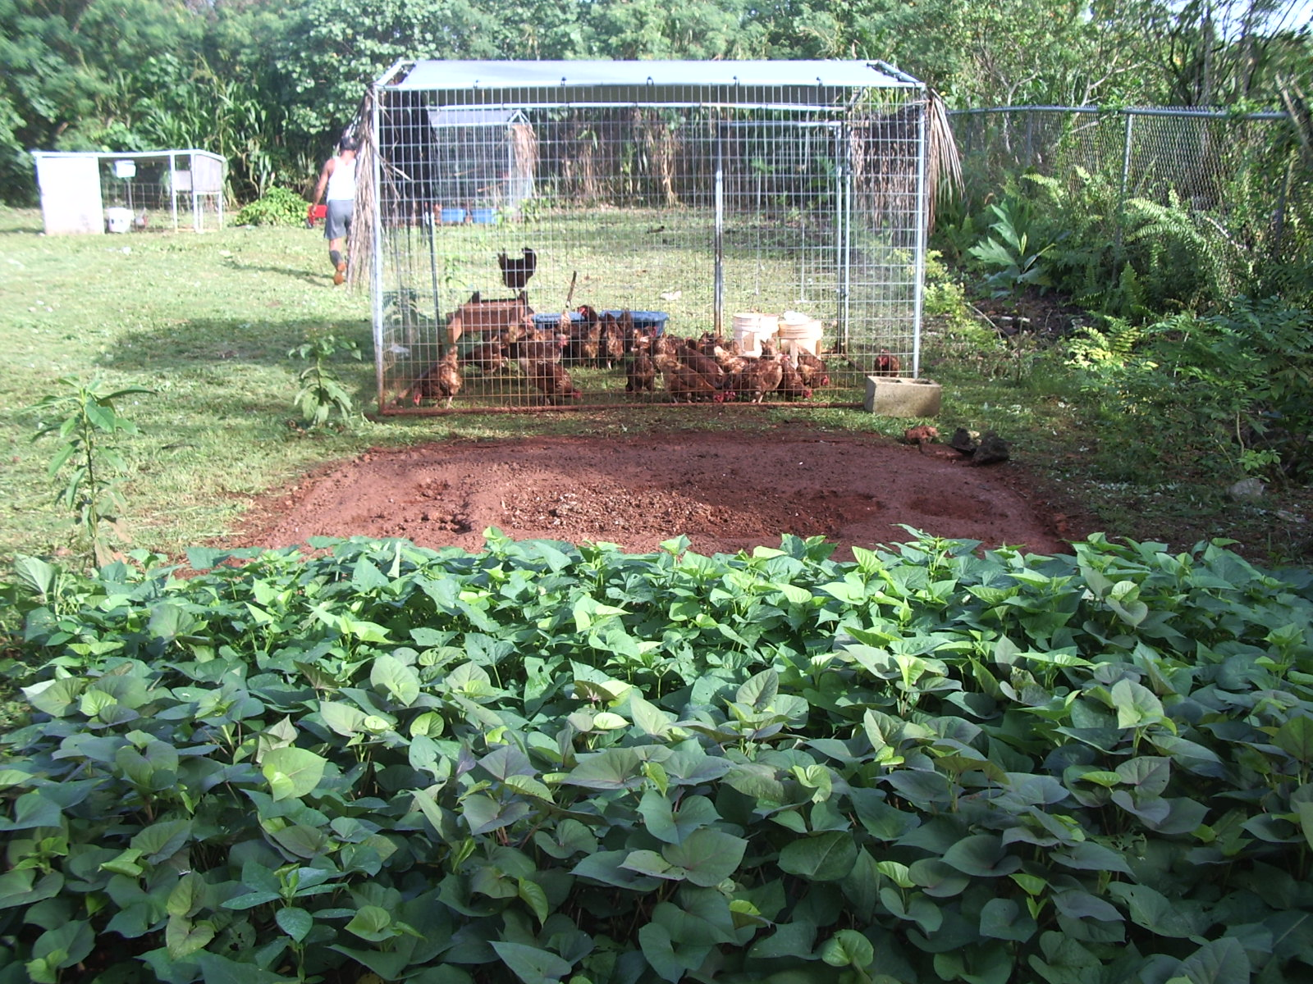
Benefits of Owning a Chicken Tractor.

Slide 8
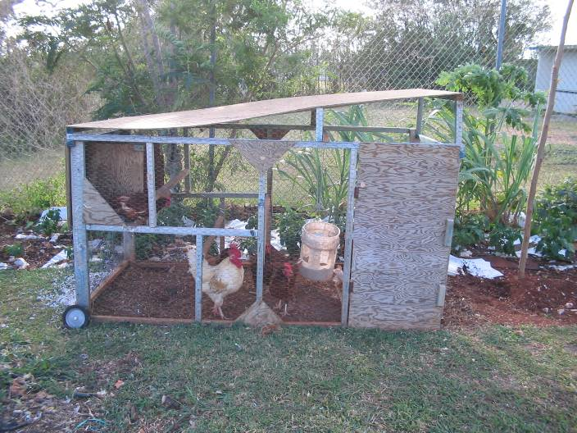
Different Types of Chicken Tractors: wood tractor

Slide 9
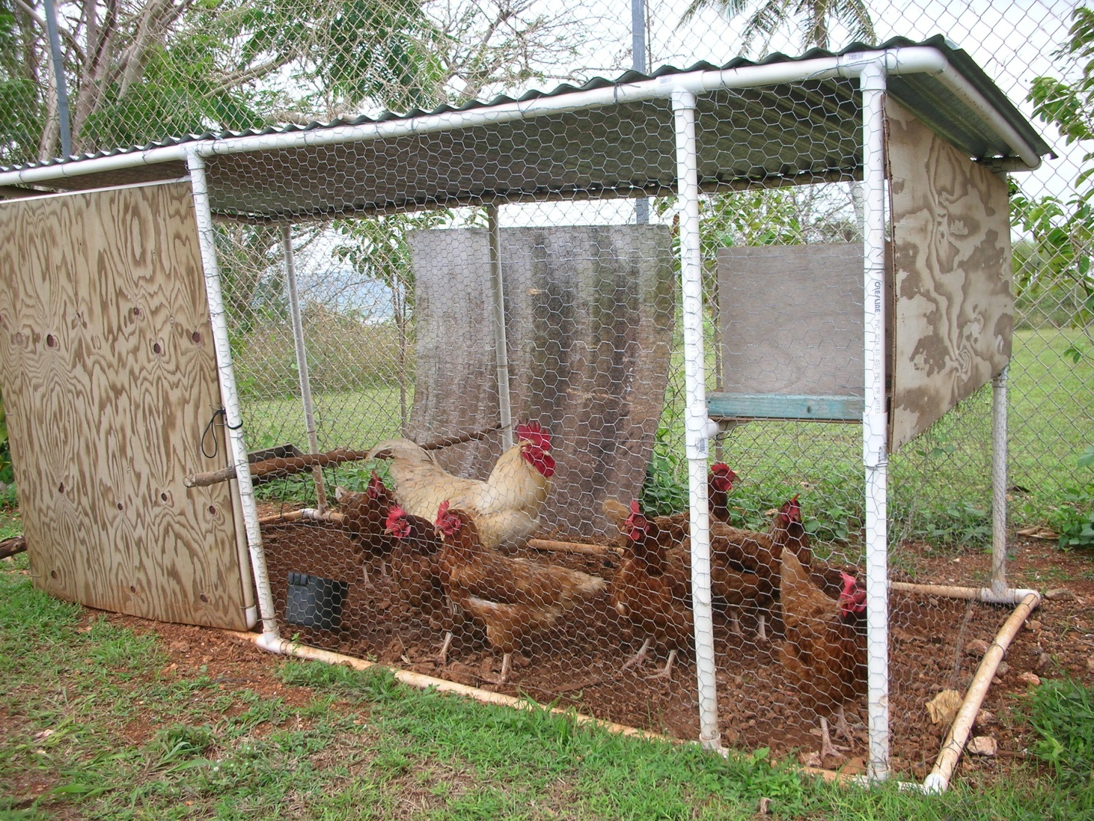
Different Types of Chicken Tractors: PVC tractor.

Slide 10
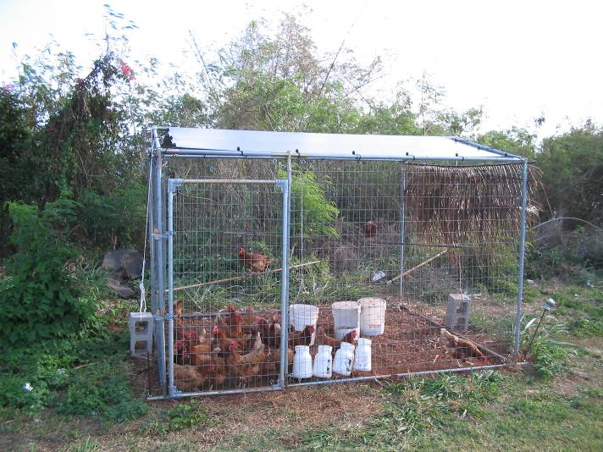
Different Types of Chicken Tractors: Light Metal Tubing (Modified Canopy)

Slide 11
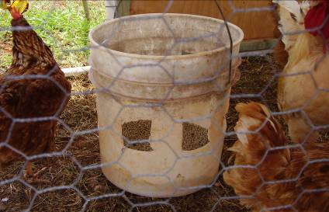
Other components of the chicken tractor:
Feeders:
  Buckets with no lid.
  Vertical slits on each side about 2-3 inches wide by 6-8 inches high.
  Hang feeder off the ground.

Slide 12
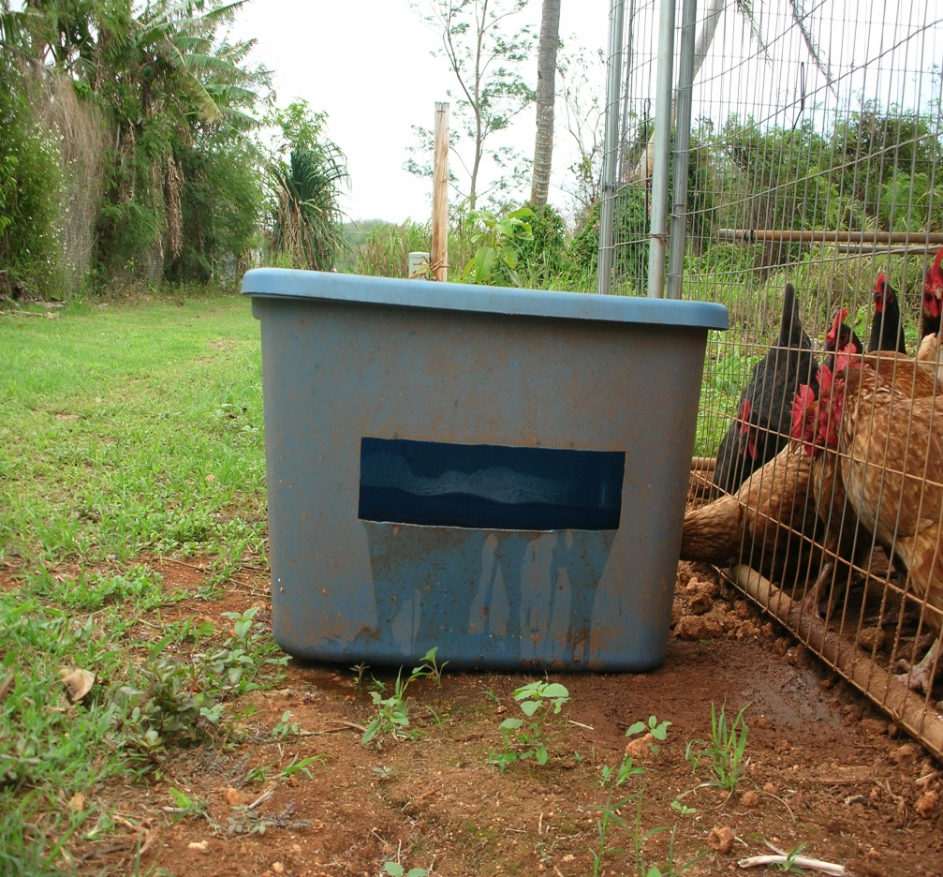
Other components of the chicken tractor:
Water retainers:
  Plastic container so chickens have access to water.
  Place water containers outside the pen so they can reach through
    Prevents chickens from getting inside
  Hang water retainers on the side of the tractor.

Slide 13
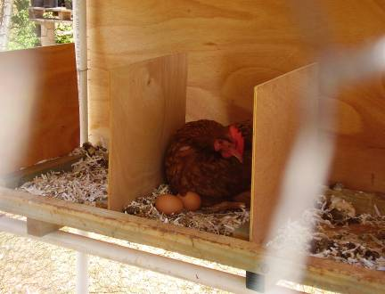
Other components of the chicken tractor:
Nesting Boxes:
  Boxes can be made out of a bucket without a lid.
  Can be made out of wood nailed together to resemble a box with an entrance.
  Use either shredded paper, straw, grass or wood chippings for lining inside the nesting box.

Slide 14
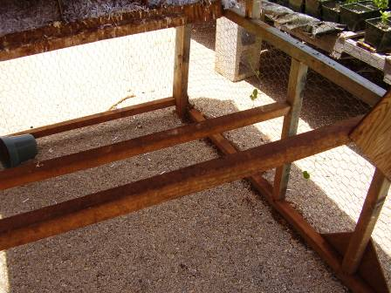
Other components of the chicken tractor:
Roosting perches:
  Inch in diameter bar.
  Run the roosting perches through the side fencing.
  Tie them on if the gaps are big enough.

Slide 15
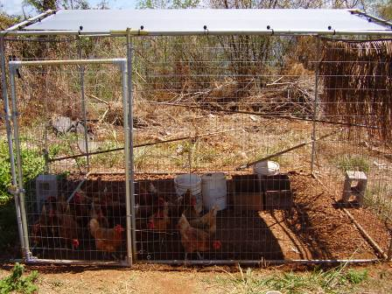
Other components of the chicken tractor:
Side shade:
  To provide chickens with shade all day long.
  Strapped half way on the top sides of the chicken tractor.
  Types:
    Tarp
    Wood
    Woven coconut fronds.

Slide 16
Conclusion
Chicken tractors are mobile pen which keep chickens confined to a small space.
The natural feeding behavior is used to the maximum advantage in the target area, clearing it of weeds
The manure fertilizers the soil
They are ideal for urban areas, chickens in tractors do not bother neighbors plants, and if frequently moved it doesn’t smell

